Slide 1


Hema Bhupathi
09/07/2024

Slide 2

Outline
Executive Summary
Introduction
Methodology
Results
Conclusion
Appendix

Slide 3
Executive Summary
Summary of methodologiesData collection
Data wrangling
EDA with Analysis
EDA with SQL
Building a Dashboard with Plotly Dash
Predective Analysis
Summary of all resultsExploratory Data Analysis Result
Interactive Analytics
Predictive Analysis

Slide 4
Introduction
Project background and contextSpaceX stands as a preeminent figure in the commercial space sector, revolutionizing space travel through affordability. Advertised on their website, Falcon 9 rocket launches boast a cost of $62 million, a significantly lower figure compared to other providers' prices, which can soar upward of $165 million per launch. This notable cost difference is primarily attributed to SpaceX's groundbreaking ability to reuse the first stage of their rockets. Thus, discerning the likelihood of a successful first stage landing becomes pivotal in calculating the overall launch cost. Leveraging publicly available data and employing machine learning models, our objective is to forecast the probability of SpaceX reusing the first stage.
Problems you want to find answersOur endeavor aims to dissect various facets surrounding the successful or failed landing of Falcon 9's first stage. Key questions guiding our investigation include unraveling the defining characteristics of both successful and unsuccessful landings. Additionally, we seek to elucidate the intricate interplay between rocket variables such as payload mass, launch site, number of flights, and orbits in influencing the outcome of a landing. Ultimately, we endeavor to uncover the optimal conditions that would bolster SpaceX's landing success rate, thereby shedding light on crucial insights for potential competitors vying for a stake in the rocket launch market.

Slide 5

Section 1

Slide 6
Methodology
Executive Summary
Data collection methodology:
Collection of data is done through two main avenues: utilizing the SpaceX REST API and employing web scraping techniques from Wikipedia.
Perform data wrangling
Utilization of One Hot Encoding technique aids in transforming categorical variables into a suitable format for binary classification.
Perform exploratory data analysis (EDA) using visualization and SQL
Perform interactive visual analytics using Folium and Plotly Dash
Perform predictive analysis using classification models
How to build, tune, evaluate classification models

Slide 7
Data Collection
The data collection process involved multiple methods:
Initially, data collection was conducted using the SpaceX API.
Subsequently, the response content was decoded into JSON format using the .json() function call. This JSON data was then normalized into a structured panda data frame using .json_normalize().
Following data acquisition, a thorough data cleaning process was initiated. This involved identifying and addressing missing values within the dataset. Missing values were filled in where necessary to ensure data completeness and integrity.
Additionally, web scraping techniques were employed to gather Falcon 9 launch records from Wikipedia. Beautiful Soup, a Python library, was utilized for this purpose, enabling the extraction of relevant data from the web page.

Slide 8
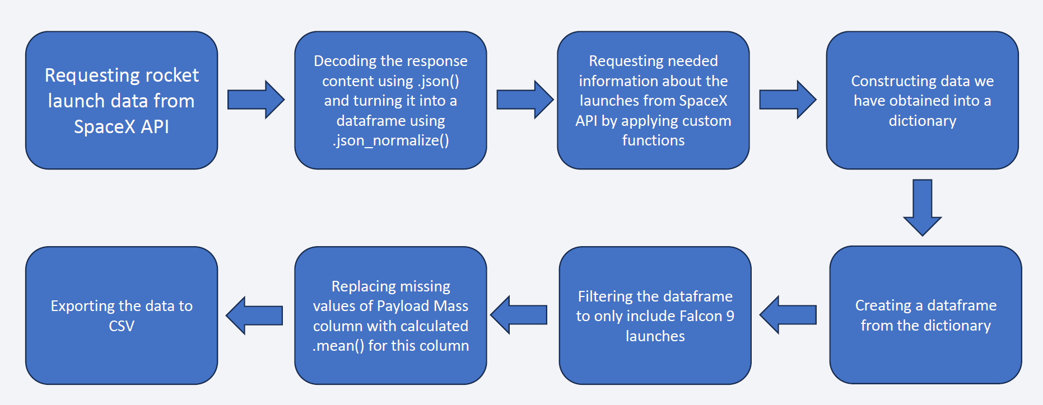
Data Collection – SpaceX API
Place your flowchart of SpaceX API calls here
https://github.com/HemaBhupathi/DataScienceEcosystem/blob/Assign/jupyter-labs-spacex-data-collection-api.ipynb

Slide 9
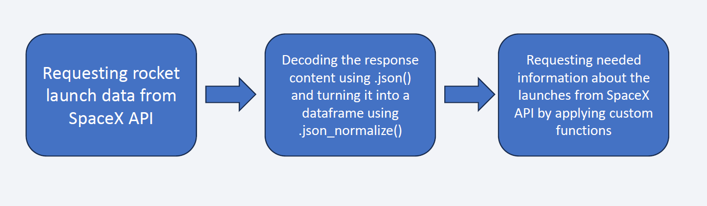
Data Collection - Scraping
Place your flowchart of web scraping here
https://github.com/HemaBhupathi/DataScienceEcosystem/blob/Assign/jupyter-labs-webscraping.ipynb

Slide 10
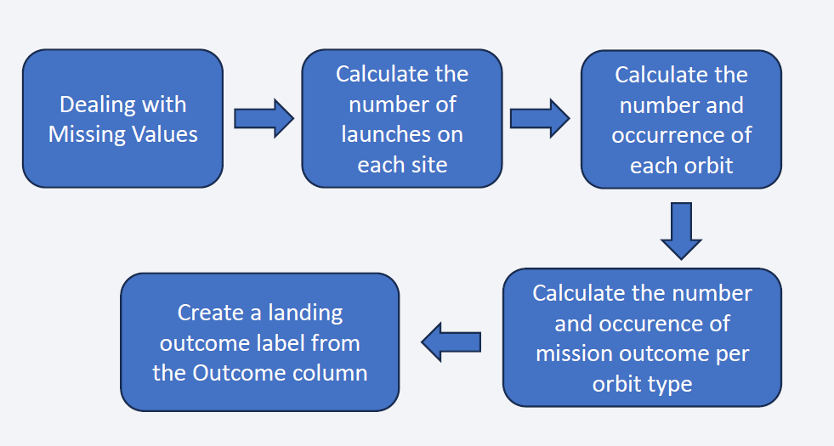
Data Wrangling
The dataset includes various scenarios where the booster did not land successfully. These scenarios encompass different outcomes based on the landing attempts. For instance, "True Ocean" indicates a successful landing in a specific region of the ocean, while "False Ocean" signifies an unsuccessful landing in the ocean. Similarly, "True RTLS" denotes a successful ground pad landing, whereas "False RTLS" indicates an unsuccessful ground pad landing. Additionally, "True ASDS" represents a successful landing on a drone ship, while "False ASDS" indicates an unsuccessful landing on a drone ship.
To simplify and standardize these outcomes for analysis, we convert them into training labels as follows: "1" denotes a successful booster landing, while "0" signifies an unsuccessful landing. This conversion allows for a uniform representation of the landing outcomes, facilitating further analysis and modeling.
https://github.com/HemaBhupathi/DataScienceEcosystem/blob/Assign/labs-jupyter-spacex-Data%20wrangling.ipynb

Slide 11
EDA with Data Visualization
Data Visualization Overview:
Scatter Graphs:
Flight Number vs. Payload Mass
Flight Number vs. Launch Site
Payload vs. Launch Site
Orbit vs. Flight Number
Payload vs. Orbit Type
Orbit vs. Payload Mass
EDA with Data Visualization:
- Bar Graph: Success rate vs. Orbit
- Line Graph: Success rate vs. Year
Key Points:
Scatter plots show correlations between variables.
Bar graphs highlight relationships between numeric and categorical variables.
Line graphs illustrate data trends over time for predictive analysis.
https://github.com/HemaBhupathi/DataScienceEcosystem/blob/Assign/edadataviz.ipynb

Slide 12
EDA with SQL
Displaying the names of unique launch sites.
Displaying 5 records where launch sites start with 'CCA'.
Total payload mass carried by NASA (CRS) boosters.
Average payload mass carried by F9 v1.1 boosters.
Date of the first successful landing on a ground pad.
Names of boosters with successful drone ship landings and payload mass between 4000 and 6000.
Total number of successful and failed mission outcomes.
Booster versions that carried the maximum payload mass.
Failed landing outcomes in drone ships, including booster versions and launch site names, for 2015.
Ranking of successful landing outcomes between June 4, 2010, and March 20, 2017, in descending order.
https://github.com/HemaBhupathi/DataScienceEcosystem/blob/Assign/jupyter-labs-eda-sql-coursera_sqllite.ipynb

Slide 13
Build an Interactive Map with Folium
Map Center: The map is centered on NASA Johnson Space Center in Houston, Texas, serving as the starting location.
Markers of Launch Sites: Red circles with labels are added at the coordinates of all launch sites, showcasing their geographical locations. The markers also indicate the proximity of the launch sites to the Equator and coastlines.
Markers of Launch Outcomes: Marker clusters are employed to group points, allowing for the display of successful (green) and failed (red) launches at each launch site. This provides insight into which launch sites have relatively high success rates.
Distances to Proximities: Colored lines are added to illustrate the distances between launch sites and key locations such as railways, highways, coastlines, and closest cities. This visual representation enhances understanding of the spatial relationships between launch sites and their surroundings.
Additional Features: Popup labels, text labels, and div icons are utilized to provide additional information and enhance the user experience. These features include labels displaying the names of launch sites, successful and unsuccessful landing outcomes, and distances to key locations.
Purpose: The interactive map serves as a comprehensive tool for visualizing launch site locations, launch outcomes, and distances to proximities. It offers valuable insights into the
https://github.com/HemaBhupathi/DataScienceEcosystem/blob/Assign/lab_jupyter_launch_site_location.ipynb

Slide 14
Build a Dashboard with Plotly Dash
Dashboard Components:
Launch Sites Dropdown List: Users can select launch sites from a dropdown list, enabling focused analysis on specific sites or viewing data collectively for all sites.
Pie Chart: A pie chart visually represents launch success, showing the total successful launches for all sites. When a specific launch site is chosen from the dropdown list, the pie chart dynamically updates to display success versus failure counts for that site.
Slider of Payload Mass Range: Users can adjust a slider to select a payload mass range, allowing for customized analysis based on payload specifications.
Scatter Chart: The scatter chart illustrates the correlation between payload mass and launch success across different booster versions, providing insights into how varying payload masses affect success rates.
Other Features:
Dropdown Component: Users can choose a launch site or view data for all launch sites using the dropdown menu.
Pie Chart: Provides a clear visualization of total success and failure counts for selected launch site(s).
Range Slider: Allows users to select payload mass within a specified range for targeted analysis.
Scatter Chart: Shows the relationship between payload mass and success rate, facilitating data exploration and understanding.
https://github.com/HemaBhupathi/DataScienceEcosystem/blob/Assign/spacex_dash_app.ipynb

Slide 15
Predictive Analysis (Classification)
Data Preparation:
Load the dataset from provided URLs
Normalize the data using StandardScaler
Split the data into training and test sets
Model Preparation:
Select machine learning algorithms: Logistic Regression, Support Vector Machine (SVM), Decision Tree, and K-Nearest Neighbors (KNN)
Set hyperparameters for each algorithm using GridSearchCV to find the best combination
Model Training:
Train each GridSearchCV model with the training dataset
Model Evaluation:
Get the best hyperparameters for each type of model
Compute the accuracy of each model using the test dataset
Plot the confusion matrix for each model
Model Comparison:
Compare the accuracy of all models
Choose the model with the best accuracy
https://github.com/HemaBhupathi/DataScienceEcosystem/blob/Assign/SpaceX_Machine%20Learning%20Prediction_Part_5.ipynb

Slide 16
Results
Exploratory data analysis results
Interactive analytics demo in screenshots
Predictive analysis results

Slide 17

Section 2

Slide 18
Flight Number vs. Launch Site
Explanation:
CCAFS SLC 40 is responsible for nearly half of all launches.
Higher success rates are observed at VAFB SLC 4E and KSC LC 39A.
The initial flights experienced failures, whereas the most recent ones achieved success.
It's plausible to assume that success rates improve with each subsequent launch.

Slide 19
Payload vs. Launch Site
Explanation:
Payload Mass and Success Rate: There is a direct relationship observed between payload mass and launch success rate across all launch sites. Generally, higher payload masses tend to correspond with higher success rates, indicating that launch sites are well-equipped to handle heavier payloads, resulting in increased mission success probabilities.
Success of Launches with Payload Mass over 7000 kg: A significant proportion of launches with payload masses exceeding 7000 kg were successful, indicating the launch sites' capability to handle and successfully execute missions with heavier payloads.
High Success Rate at KSC LC 39A: KSC LC 39A boasts an impressive 100% success rate for launches with payload masses under 5500 kg. This highlights the reliability and effectiveness of the launch site's infrastructure and operations, particularly for missions with smaller to moderate payload masses.

Slide 20
Success Rate vs. Orbit Type
Explanation:
Orbits with a perfect success rate include ES-L1, GEO, HEO, and SSO.
Orbits with no successful missions are limited to SO.
Orbits with success rates ranging from 50% to 85% encompass GTO, ISS, LEO, MEO, and PO.

Slide 21
Flight Number vs. Orbit Type
We observe a positive correlation between the success rate and the number of flights for the LEO orbit. Conversely, for orbits like GTO, there appears to be no discernible relationship between the success rate and the number of flights. However, it's reasonable to infer that the high success rates observed for orbits such as SSO or HEO may be attributed to knowledge gained from previous launches for other orbits.

Slide 22
Payload vs. Orbit Type
The weight of payloads can significantly impact the success rate of launches in specific orbits. For instance, in the LEO orbit, heavier payloads tend to enhance the success rate. Conversely, reducing the payload weight for a GTO orbit has been found to improve launch success.

Slide 23
Launch Success Yearly Trend
The success rate has shown a consistent increase from 2013 to 2020.

Slide 24
All Launch Site Names
Presenting the names of the distinct launch sites involved in space missions..

Slide 25
Launch Site Names Begin with 'CCA'
Displaying five records where launch sites initiate with the string 'CCA'.

Slide 26
Total Payload Mass
Showing the cumulative payload mass transported by boosters launched by NASA (CRS).

Slide 27
Average Payload Mass by F9 v1.1
Indicating the mean payload mass carried by booster version F9 v1.1.

Slide 28
First Successful Ground Landing Date
Listing the date of the inaugural successful landing outcome on a ground pad.

Slide 29
Successful Drone Ship Landing with Payload between 4000 and 6000
Enumerating the booster names that achieved success in drone ship landings with payload masses greater than 4000 but less than 6000.

Slide 30
Total Number of Successful and Failure Mission Outcomes
Enumerating the overall count of successful and failed mission outcomes.

Slide 31
Boosters Carried Maximum Payload
Displaying the names of booster versions that transported the maximum payload mass.

Slide 32
2015 Launch Records
Listing instances of failed landing outcomes on drone ships, alongside their booster versions and launch site names for the months in the year 2015.

Slide 33
Rank Landing Outcomes Between 2010-06-04 and 2017-03-20
Ranking the frequency of landing outcomes (e.g., Failure (drone ship) or Success (ground pad)) between June 4, 2010, and March 20, 2017, in descending order.

Slide 34

Section 3

Slide 35
Ground Station
Most launch sites are strategically situated near the Equator line. This positioning takes advantage of the Earth's rapid rotation at the equator, with speeds reaching 1670 km/hour. Launching from the equator allows spacecraft to leverage this inertia, aiding in maintaining orbital velocities.
Additionally, all launch sites are located in close proximity to coastlines. Launching rockets over the ocean minimizes the risk of debris falling or exploding near populated areas, ensuring safety during launches.

Slide 36
Color launch records
Color-labeled markers facilitate the easy identification of launch sites with relatively high success rates.
Green Marker = Successful Launch
Red Marker = Failed Launch
Notably, a certain launch site exhibits a notably high success rate, as indicated by the markers.

Slide 37
Distance from the launch site to proximity
Explanation:
Visual analysis reveals that the launch site is situated:
relatively close to a railway (15.23 km)
relatively close to a highway (20.28 km)
relatively close to a coastline (14.99 km)
Additionally, the launch site is in close proximity to its nearest city (16.32 km).
Considering the high speeds of failed rockets, covering distances of 15-20 km within seconds, the proximity to populated areas poses potential safety concerns.

Slide 38

Section 4

Slide 39
Launch Success
The graph displays that KSC LC-39A leads in successful launches among all sites.

Slide 40
Highest Launch
KSC LC-39A boasts the highest launch success rate (76.9%) with 10 successful and only 3 failed landings.

Slide 41
Payload Mass vs Launch Outcome
Low-weighted payloads have a better success rate than the heavy-weighted payloads.

Slide 42

Section 5

Slide 43
Classification Accuracy
Relying solely on Test Set scores doesn't definitively establish the best-performing method.
•Similar Test Set scores across methods may stem from the small sample size (18 samples). Consequently, all methods underwent evaluation using the entire Dataset.
•Examination of scores from the entire Dataset identifies the Decision Tree Model as the top performer. This model not only achieves higher scores but also maintains the highest accuracy.

Slide 44
Confusion Matrix
As the test accuracy are all equal, the confusion matrices are also identical. The main problem of these models are false positives.

Slide 45
Conclusions
Success in space missions depends on various factors, including the launch site, orbit, and payload mass, as well as cumulative launch experience.
Orbits such as GEO, HEO, SSO, and ES-L1 demonstrate remarkable success rates, indicating their reliability for space missions.
Payload mass plays a crucial role in mission success, with lighter payloads generally showing better outcomes compared to heavier ones.
Despite similar test accuracies among models, the Decision Tree Algorithm is favored due to its superior train accuracy.
The reasons behind disparities in launch site performance, notably KSC LC-39A's superiority, remain unclear and warrant further investigation.
The consistent upward trend in launch success rates over the years reflects advancements in space exploration.

Slide 46
Appendix
Thank you

Slide 47


